Slide 1
Process Session 2
Course : COMP6153
Effective Period : September 2018

Slide 2
Sub Topics
PCB
Process States
The Creation and Termination of a Process
Process Management System Call

Slide 3
These slides have been adapted from: Stallings, W. (2011). Operating Systems: Internals and Design Principles. 8^{th.} ISBN: 978-0-13-380591-8 Chapter 3
Acknowledgement

Slide 4
Learning Objectives
At the end of this lecture, students are able to:
LO2 : Relate the fundamental design of Processes to the current development of Operating System
LO4 : Demonstrate the skills in using Java programming language in writing user programs related to process management

Slide 5
Process
A program in execution
An instance of a program running on a computer
The entity that can be assigned to and executed on a processor
A unit of activity characterized by the execution of a sequence of instructions,
a current state, and an associated set of system resources

Slide 6
Process Characteristic
A unique process identifier
State
Priority
Program Counter
Memory pointers
Context Data
I/O status information
Accounting information

Slide 7
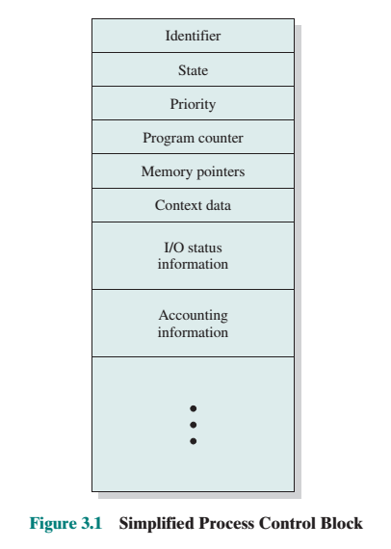
Process Control Block
Contains the process elements
It is possible to interrupt a running process and later resume execution as if the interruption had not occurred
Created and managed by the operating system
Key tool that allows support for multiple processes

Slide 8
Process States
Trace
the behavior of an individual process by listing the sequence of instructions that execute for that process
the behavior of the processor can be characterized by showing how the traces of the various processes are interleaved
Dispatcher
small program that switches the processor from one process to another

Slide 9
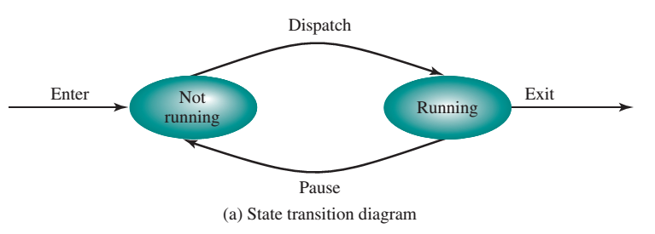
Two State Process Model

Slide 10
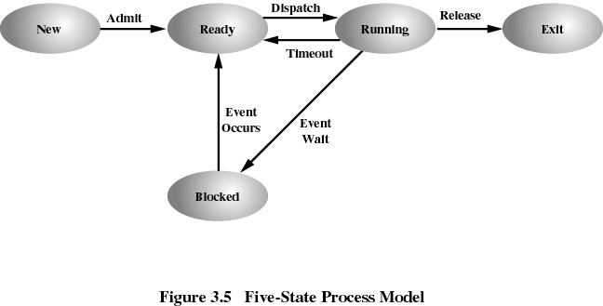
Five State Process Model

Slide 11
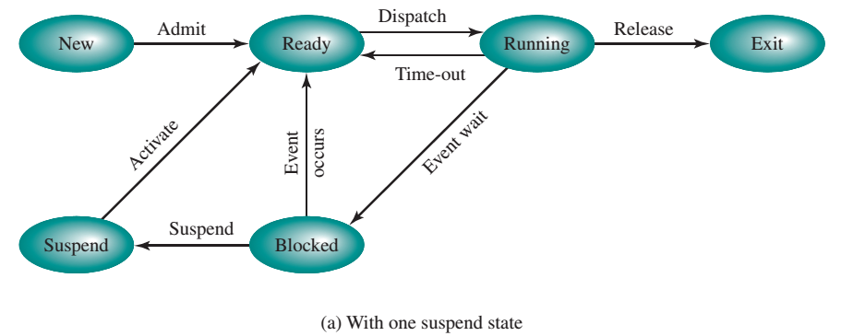
Process Model with one suspend state

Slide 12
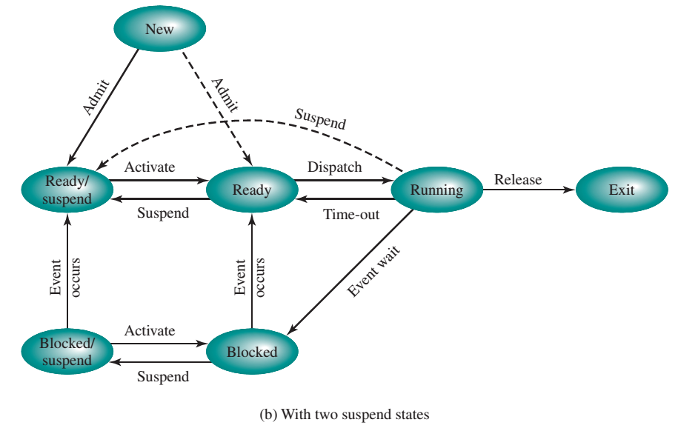
Process Model with two suspend state
Blocked/Suspend:The process is in secondary memory and awaiting an event.
Ready/Suspend:The process is in secondary memory but is available for execution as soon as it is loaded into main memory.

Slide 13
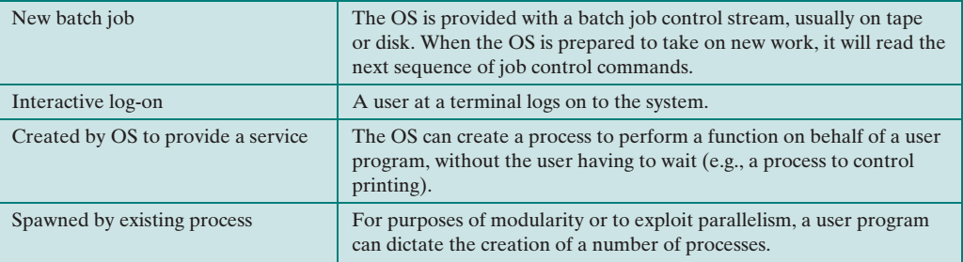
Process Creation

Slide 14
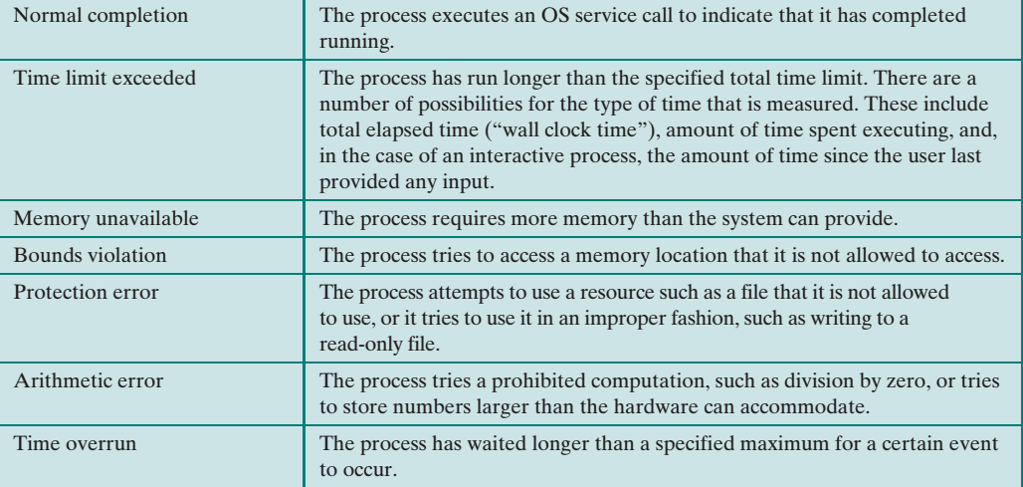
Process Termination

Slide 15
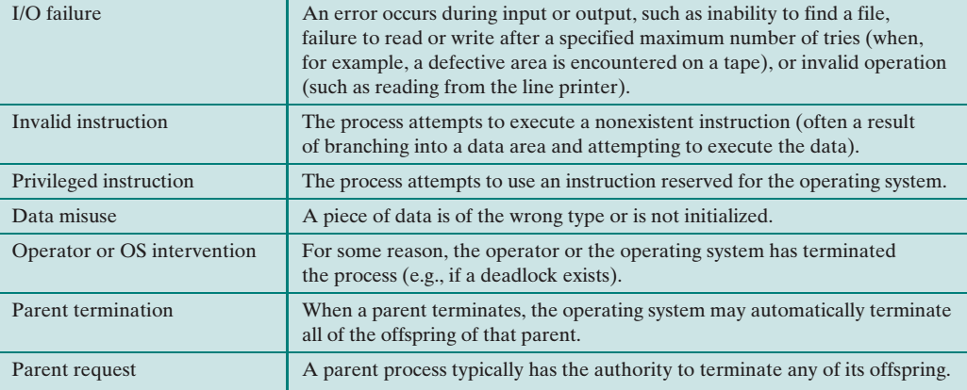
Process Termination

Slide 16
Suspended Process- Characteristics
The process is not immediately available for execution
The process may or may not be waiting on an event
The process was placed in a suspended state by an agent: either itself, a parent process, or the OS, for the purpose of preventing its execution
The process may not be removed from this state until the agent explicitly orders the removal

Slide 17
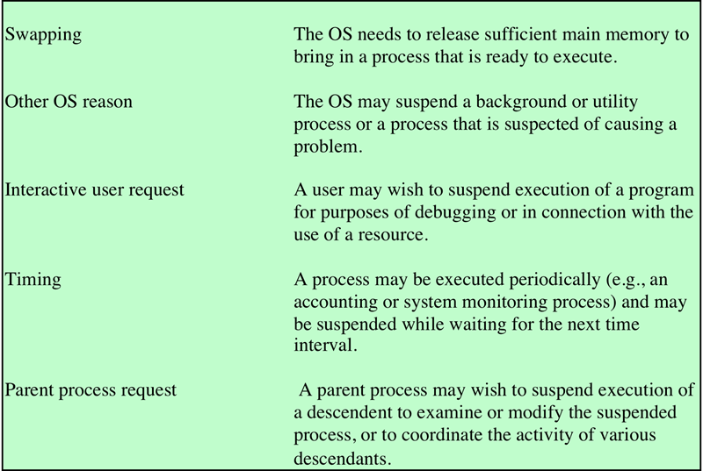
Reason for Process Suspension

Slide 18
Reason for Process switch
Clock interrupt
process has executed for the maximum allowable time slice
I/O interrupt
Memory fault
memory address is in virtual memory so it must be brought into main memory
Trap
error occurred
may cause process to be moved to Exit state
Supervisor call
such as file open

Slide 19
Modes of Execution
User mode
Less-privileged mode
User programs typically execute in this mode
System mode, control mode, or kernel mode
More-privileged mode
Kernel of the operating system

Slide 20
Process Management System Call – fork()
Creates a new process (child)
Parent and children execute concurrently
Each process can fork another process thus creating a process hierarchy
A process can choose to wait for its child to terminate

Slide 21
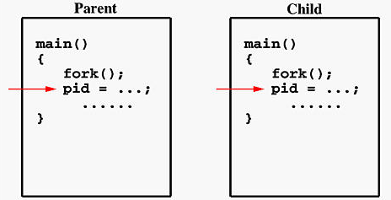
fork()
When fork() is executed, it makes two identical copies of the address space
Both processes start execution afterwards
Therefore parent and child runs independently
Source: http://www.csl.mtu.edu/cs4411.ck/www/NOTES/process/fork/create.html

Slide 22
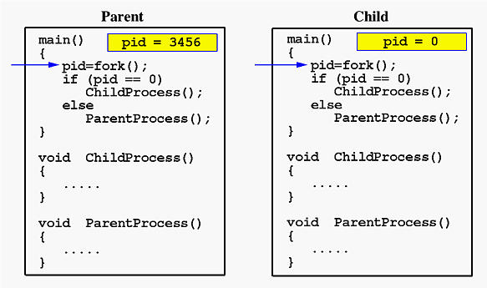
fork()
Source: http://www.csl.mtu.edu/cs4411.ck/www/NOTES/process/fork/create.html

Slide 23
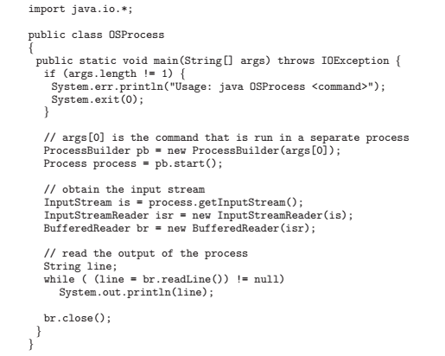
Create a process using Java API
Source: Operating Systems Concepts with Java 8ed, Silberschatz and Gagne

Slide 24
system()
Executes a command from within a program
Much as if the command had been typed into a shell
Creates a subprocess running the standard Bourne shell
(/bin/sh) and hands the command to that shell for
execution; subject to the features, limitations and security of
the shell; on most GNU/Linux systems, pointing to bash

Slide 25
Running command from Java
import java.io.*; public class Discfree { public static void main (String [] args) throws IOException { String [] Command = null; if (System.getProperty("os.name").equals("Linux")) { Command = new String[1]; Command[0] = "df"; } if (Command == null) { System.out.print("Can't find free space on "); System.out.println(System.getProperty("os.name")); System.exit(1); }
Operating Systems Concepts 8th ed with Java, Silberschatz, Galvin and Gagne

Slide 26
Running command from Java
Process Findspace = Runtime.getRuntime().exec(Command); BufferedReader Resultset = new BufferedReader( new InputStreamReader ( Findspace.getInputStream())); String line; while ((line = Resultset.readLine()) != null) { System.out.println(line); } } }
Operating Systems Concepts 8th ed with Java, Silberschatz, Galvin and Gagne

Slide 27
References
Stallings, W. (2014). Operating Systems: Internals and Design Principles. 8^{th.} ISBN: 978-0-13-380591-8
Abraham Silberschatz, Peter B. Galvin, Greg Gagne (2010). Operating System Concepts 8th ed. With Java
ISBN: 978-0-470-50949-4

